Slide 1
Managing Object Creation
IN710 OOSD 2016
Session 5.1
Notes:
Demo game first

Slide 2
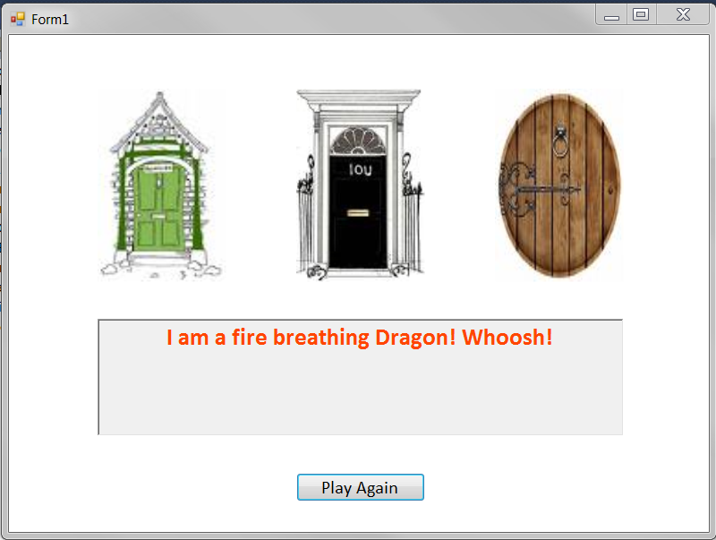
The Mystery Door Game
Notes:
This is a simple game
There are four kinds of characters – vampires, witches, dragons and golden geese
Game characters hold a string called ‘message’ to which is their behaviour (in place of an animation, say). For example, witches say ‘I am a witch! Cackle!’
They each have a text colour that they want their text message to be printed in (we use a richTextBox control for this).
There is a gameEngine class that holds a collection of these characters and a richTextBox for printing.
There is a Form class that provides the screen.
Characters are randomly allocated to doors (duplication is permitted).
The player clicks on a door, and the character behind it is revealed by the contents of the rtb.
The goal is to get the Goose.
We are going to look at the very simple code of this very simple game closely
We will be able to see a common sort of problem, and then learn the design pattern to fix it
We will start with the game characters

Slide 3
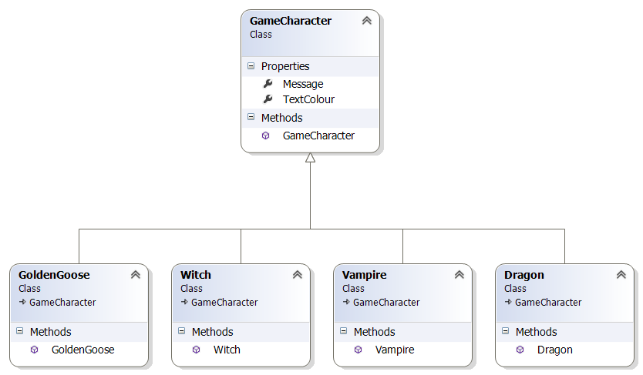
The Mystery Door Game
Notes:
So here is the game character class hierarchy...
In reality these classes are so simple we might not make this architecture, we’d just set the message string and text colour and get on with it. But we make these separate classes on the assumption that in a real game the characters would be complex things with some common data and methods and some need for polymorphism, as we have often seen.

Slide 4
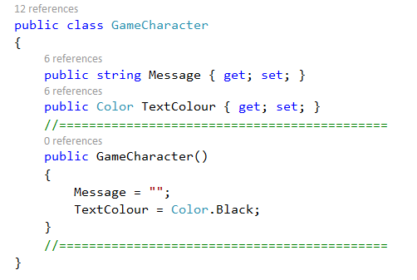
The Mystery Door Game
Notes:
Here is the base class
Again, in a real situation there would be lots of stuff going on here, but in this simple example, we’ll just pop some data in here.
I’ve chosen some sensible defaults here – you could have left it empty.
Note that the whole abstract/virtual discussion doesn’t apply to constructors. All children should have their own constructors, regardless. Sometimes all that happens is that they call the parent’s constructor (base) but they still have their own.
The game engine class will access the data and use it.

Slide 5
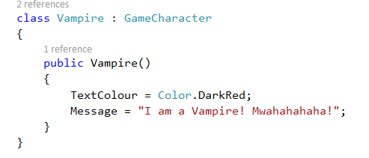
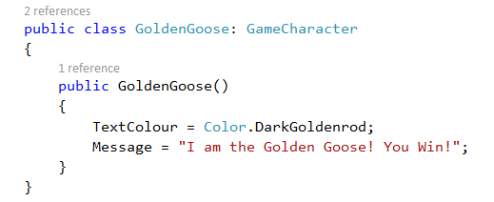
The Mystery Door Game
Notes:
And here are two of the concrete child classes
They only need to set up their class-specific data values in a constructor.
Again, the architecture is too heavy for the example – just imagine that there was lots of code in the base class for animation, path-finding, etc.
The others you can figure out

Slide 6
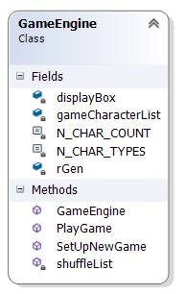
The Mystery Door Game
Notes:
Here is GameEngine
His job is to run the game and to keep the Form and the Characters uncoupled.
It would not be unreasonable in a real game to break this up into two classes, but we don’t want the example to get out of hand.
It has a List<GameCharacter>. A list of the base class can be filled with any child instances (remember cat and dog are both mammals).
A constant to tell it how many character types it can choose from and how many it needs (the number of doors)
A richTextBox to output the Character’s messages and apply their colours.
A random generator for random assignment and shuffling.
Methods: constructor, game setup, shuffle and game play

Slide 7
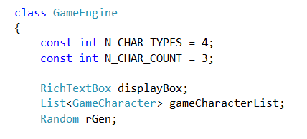
GameEngine Fields
Notes:
The start of the class, showing the class data fields

Slide 8
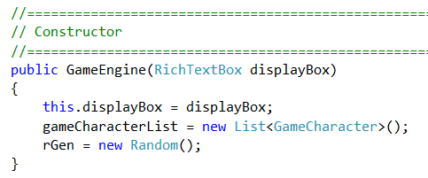
Game Engine Methods
Notes:
Constructor

Slide 9
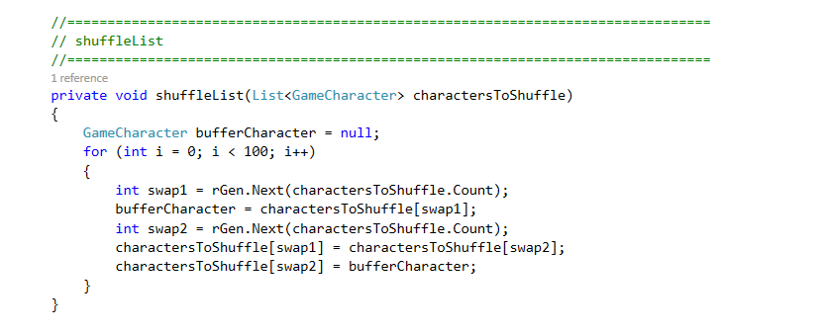
Game Engine Methods
Notes:
A simple shuffle algorithm…
We’ll look in a minute at how we put the characters into the list.

Slide 10
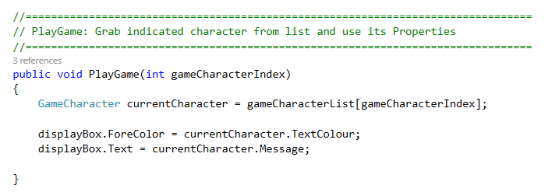
Game Engine Methods
Notes:
The PlayGame method…
The Form will pass in the index via the pictureBox onclick handlers. PictureBox1 calls PlayGame(0), PictureBox2 calls PlayGame(1)...
Grab the values and use them – access the character in the corresponding position and output appropriately to the rtb. (No logic for determining the win, but there could be some.)
Let’s just see what that looks like in the Form….

Slide 11
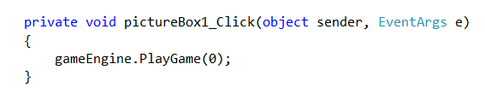
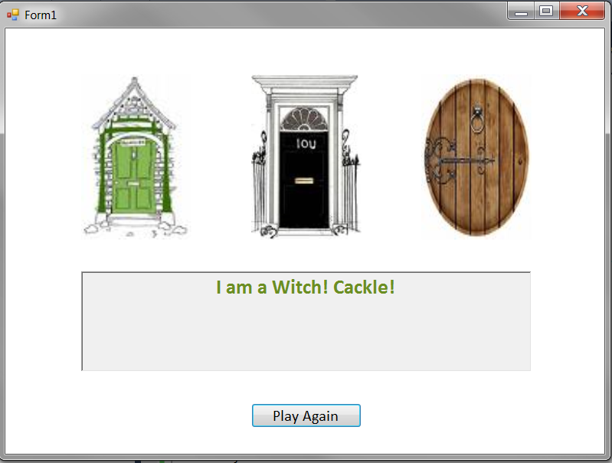
The Mystery Door Game
Notes:
So if you click on door1 (pictureBox1) this is the code that is executed.
If there is a witch “behind door 1”, (i.e. in the first position of the GameEngine’s character list), you see this.
All good so far?
So let’s look now carefully at the method where the problem arises.
This is the setUpGame method of GameEngine
It is called in Form_Load to start things, and it is called every time someone clicks the new game button

Slide 12
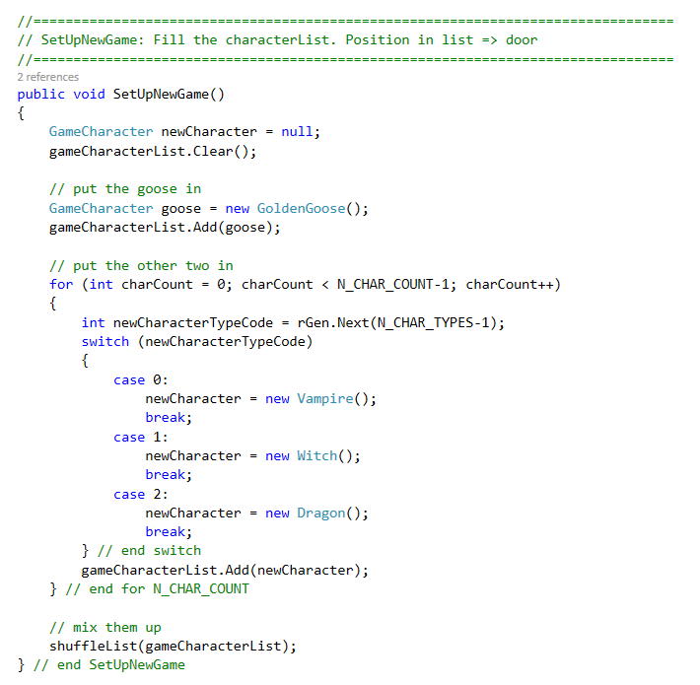
Game Engine Methods
Notes:
The method we are really interested in.
This method belongs to the GameEngine class
This is the method called to set up a new game
The main work here is to create new characters and add them to the list, for playGame() and shuffle() to use.
First, we put in the goose.
Then, for the other doors, it generates a random number, then uses that to decide what kind of game character to put behind the door. Given the OOAD principles we have been going on and on about so far, what is wrong with this code?
If you can’t see it, consider what would happen if we decided to add a new kind of game character, say a Unicorn.
We are making a change to the GameCharacter class hierarchy, but we will have to touch the code here (specifically, the switch statement) in the GameEngine class.
This is Bad, and arises because GameEngine and GameCharacter are coupled.
And in a real game, think about how many different points in the main game code you might need to create a new game character. Will you have a switch statement at every one of them? Will you modify all of them when you add a new character? Ew?
How can we modify our implementation so that we can freely add new game characters and not have to touch the GameEngine class?

Slide 13
Useful Rule
“Encapsulate what varies”
In our game, one thing that might change is the production of game characters.
GameEngine
coupled ☹
uses
Character Factory
creates
Game Characters
Notes:
This is a good guide for OO.
We want to be graceful under change
If we can identify the things that will change and encapsulate them, we can localise the impact.
We can protect other elements
In our game, what can change is the choice and production of game characters. So that is what we want to encapsulate
And what is the OO way to encapsulate something?
Make it a class
This kind of class is called a ‘factory’.
Its sole responsibility is to produce objects according to some rule, and return them
It’s kind of like a constructor machine.
Let’s look at the code for the character factory...

Slide 14
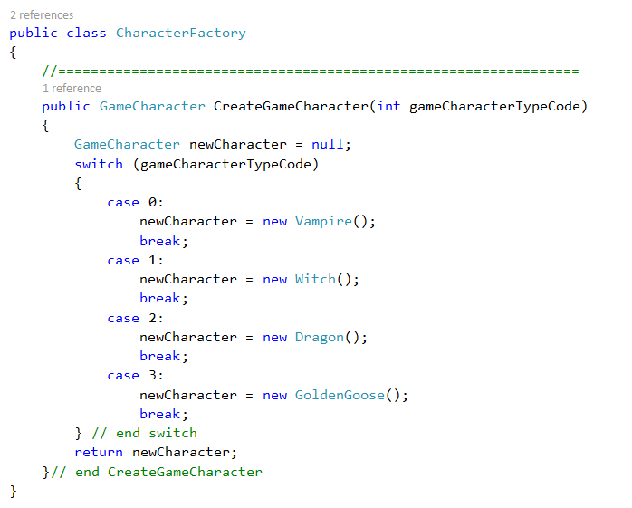
CharacterFactory
Notes:
It only has one method....(plus an empty constructor for completeness, not shown here.)
We have taken the code that is sensitive to change (the switch statement used to create a new character) and we have removed it from GameEngine and placed it in its own class
So what happens to GameEngine.SetUpGame()……?

Slide 15
Old GameEngine Code
Notes:
Before…

Slide 16
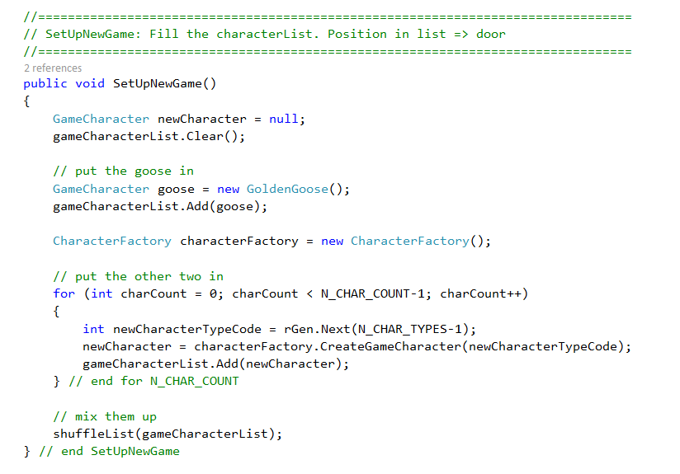
New GameEngine Code
Notes:
GameEngine code now..
Note that we could have created the factory in the constructor.
I just put it here so you could see it being created...
Now isn’t this nice code?
What happens to GameEngine if you need to add unicorns? NOTHING (except updating the N_CHAR_TYPES constant, which isn’t architectural – IRL would probably be read in from some config file, so no code would change).
Only the factory class changes.
In fact, the GameEngine doesn’t know anything about the actual product it uses.
If you wanted to change the game so that there were bunny rabbits, or space alien vehicles or quotes from Shakespeare behind the doors, it wouldn’t make any difference at all. ⬅ Yay!!!
Compare how much knowledge GameEngine has about the Character family in the before and after versions. Knowledge = coupling. Coupling = brittle code.

Slide 17
Question that’s Bothering You
“But aren’t the GameCharacter classes and the CharacterFactory class coupled?”
Notes:
Isn’t the factory now violating the Open/Closed principle?
The answer is yes.
But it is basically the GameFactory’s job (SRP) to be coupled to the GameCharacter hierarchy.
As opposed to the GameEngine class, who has a different responsibility (managing the game data and logic).
The CharacterFactory encapsulates the necessary coupling, isolating GameEngine from it.
You won’t break other functionality in CharacterFactory, because there isn’t any.
And the coupling is localised to one place in the system, not spread around to every location that you need to create a character.

Slide 18
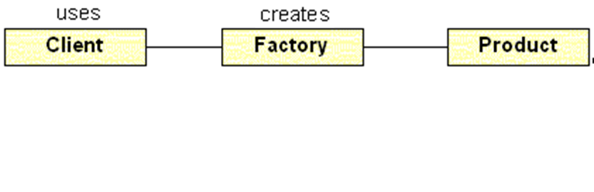
The Simple Factory
“Decoupling object use and creation by delegating the creation process to a dedicated class.”
Notes:
The technique we have just seen is called the simple factory pattern
If you ever have a class method that contains logic to create one of a number of other class instances, you should consider encapsulating that logic into its own class (a Factory).
Then, instead of peppering that logic all over the place in the consumer class, it resides only in the Factory, and the consumer class simply talks to the Factory object as needed.
Although quite useful, it is not one of the official 23 GoF patterns.
The GoF contains a number of more complex factory-based patterns, and we will see the most important one next.

Slide 19
Complex Factories
Sometimes, the object creation behaviour you want to encapsulate is more complex.
Base Class: Generates some object (common behaviour)
Child Class 1: needs concrete objects from Set 1
Child Class 2 needs concrete objects from Set 2
Child Class n: needs concrete objects from Set n
……..
Notes:
In the Mystery Door, we had one class (GameEngine) who needed to create instances from a set of objects.
But in some situations, the creation logic can be more complex.
For example, you might have a class hierarchy. Each child needs to generate some objects for some common behaviour, but the actual concrete objects needed differs from child to child.
Imagine a family of different games that use different character sets.
How will we manage our factory behaviour now?
We could make one giant factory that provided all the different objects – Child Class 1 asks for objects 0 to 5; Child Class 2 asks for objects from 6 to 10; Child Class 3 asks for objects from 11 to 15, etc.
But this is unwieldy and inelegant. Each child class is holding a factory that does a lot of work that it doesn’t need. Changes to that part of the factory’s code (that part of the switch statement) could break the child class even though it never even uses it.
It would be better to have each child class have a factory that only does the work it needs. So we have many factories that do the same job (produce characters) but implement that job in different ways (polymorphically).
Recognise this? => This is inheritance/interface ➔ We need not a single factory class, but a family of factory classes. One factory child for each class child of the main hierarchy.
Let’s look at an example…

Slide 20

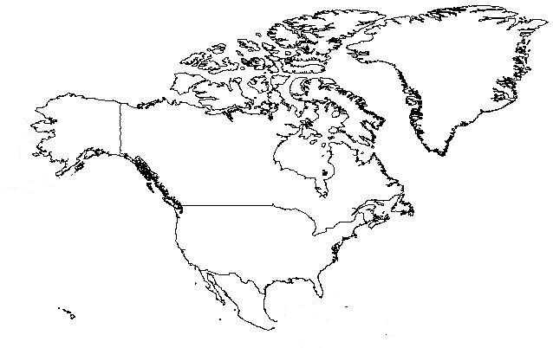
More Complex Factories
Notes:
Based on an example from dofactory.com
Let’s say that you are building some sort of zoological simulator of the type used in habitat management, or climate change prediction, or something.
For simplicity, we’ll show only North America and Australia, but of course, the architecture should scale elegantly to as many land masses as you want

Slide 21













More Complex Factories
Notes:
Each continent needs to simulate the appropriate flora and fauna.
For example, in Australia we need to create koalas, crocodiles and kangaroos
In North America, we need to create eagles, bison and wolves
The continents will have common data and behaviour, so are likely to be descendants of a common base class
The animals will have common data and behaviour, so are likely to be descendants of another common base class
Start thinking now...Keeping in mind that the purpose of the Factory approach is to decouple object use from object creation, what architecture might we use here that would be clean and scalable?

Slide 22
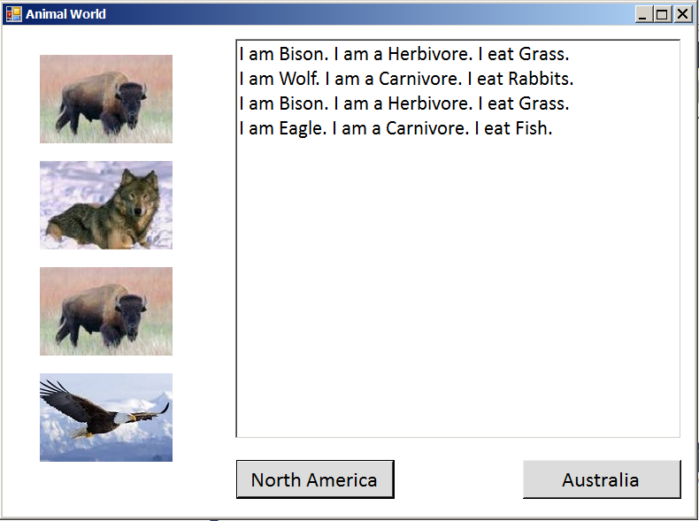
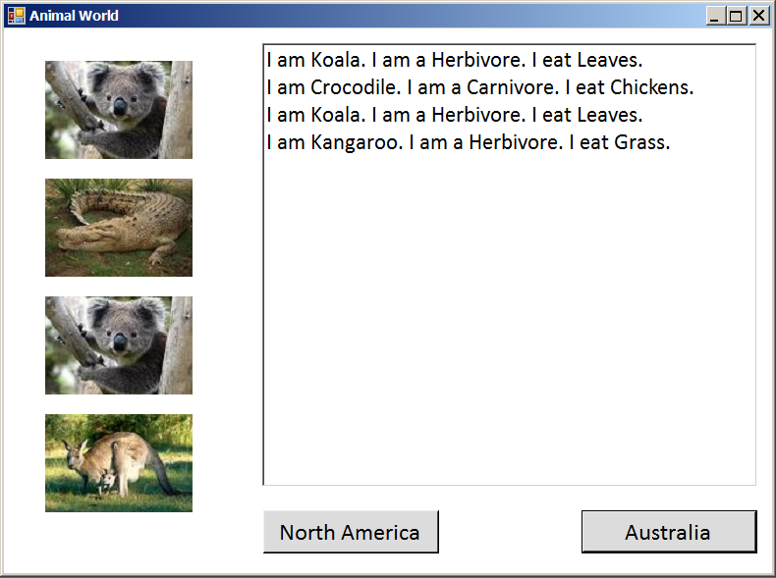
Animal World
Notes:
The actual program we will build is very, very simple in its behaviour
It just creates three randomly selected animals, then dumps their information out to a listbox and the canvas.
The architecture, of course, would be unchanged if you added more functionality, like reproduction, migration, predator-prey relationships, etc.
This behaviour of the continents is the same, so is all contained in the base class. In a real simulation, there would be additional non-common stuff.
This screen shows two snapshots of a single application – one for the NA button and one for the Australia button.
We have two continent child instances (NA and Aus). In each button, we call some sort of RunSimulation method on the corresponding concrete instance.

Slide 23
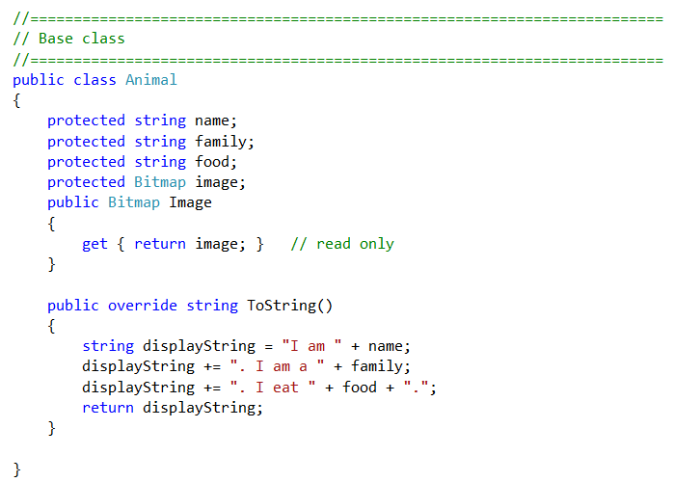
Animal World
Notes:
We’ll start with the Animal classes, because they are the simplest
For our very simple example, we might have something like this...
The base class…

Slide 24
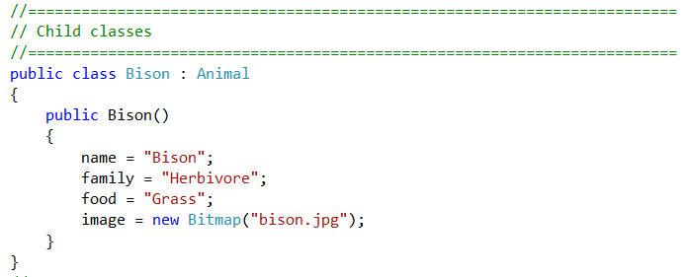
Animal World
Notes:
…and one of the animals.
Again, we note that these children actually differ only in data. In this situation we probably wouldn’t descend, as there is no polymorphism. But we are just trying to keep the functionality very simple so we can concentrate on the architecture. If it is useful to you, pretend there are hundreds of polymorphic methods in Animal hierarchy as well, we just can’t see them.
The architecture works the same no matter how fancy you made the animals

Slide 25
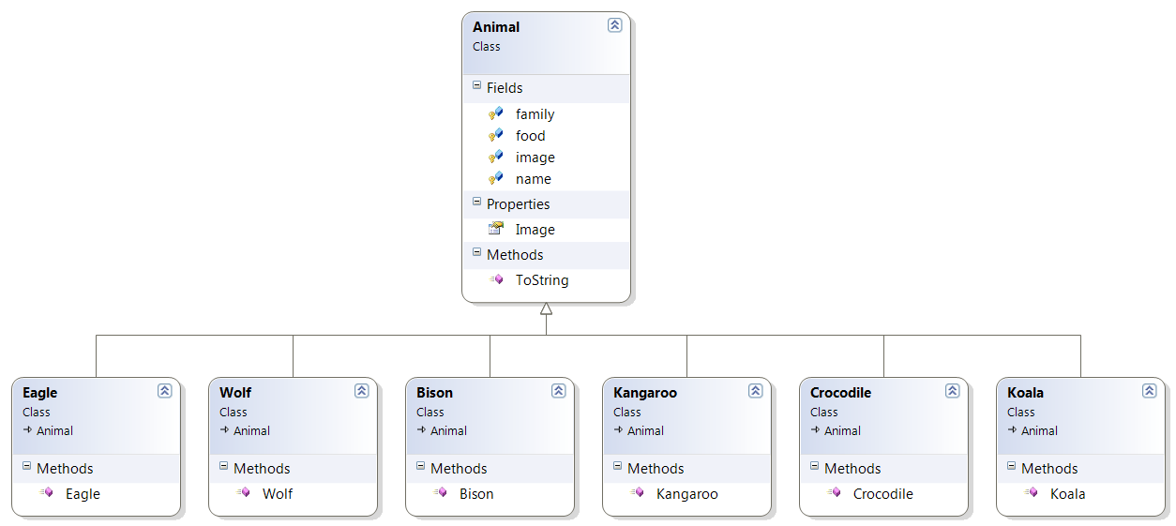
Animal World
Notes:
Put them all together into something like this
Again, in a real simulation you might have various subtrees going, but this will do for us, because all of our animals behave the same

Slide 26
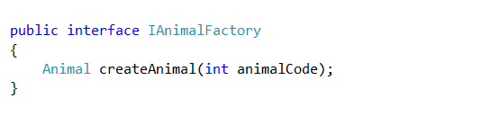
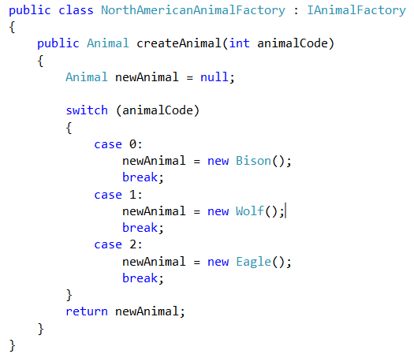
Animal World
Notes:
Next, we’ll make the factories
An animal factory is just a method, so we could sensibly make it an interface. If you need data or default methods, make an abstract class.
We could then declare two concrete factories, one for each continent.
They implement the interface, so we can use the same code in the simulator regardless of which kind of animals we make – the methods we call will be the same.
Here is the NA one. We group all the NA animals together here.
What would the Australian one look like?

Slide 27
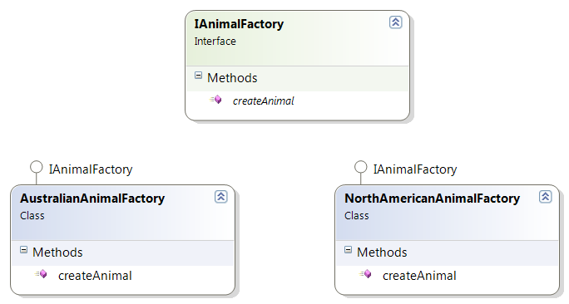
Animal World
Notes:
So the Factory hierarchy looks like this
You should see that it would be very straightforward to add additional factories for more continents

Slide 28
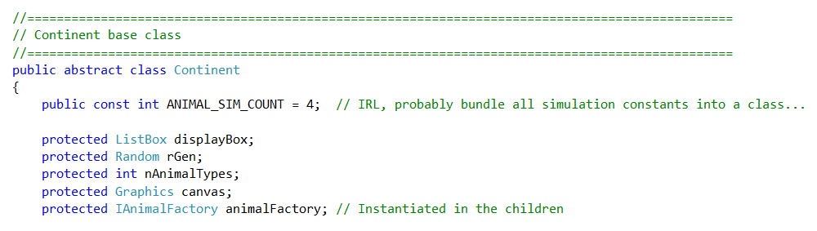
Continent Fields
Notes:
And finally, we consider the continents themselves.
They will be responsible for running the simulation, so they need the simulation parameters and controls for displaying (we allow a little UI coupling here to keep things simple – add an intermediate class to reduce this if you wish).
They will also need a factory to use to create their animals.
What is the type of the factory? ➔ IAnimalFactory (or the factory base class if you implemented as an abstract class).
Which factory do they get? ➔The one that produces the kind of animals they need
When do they get their factory object? ➔ In their constructor
If you had some kind of reason to do so (zombie alien virus plague?) and wanted to change at runtime the kind of animals that a continent produced, would it be hard? ➔ No. (so there is a sense of the strategy pattern here as well...the principles are strong...)

Slide 29
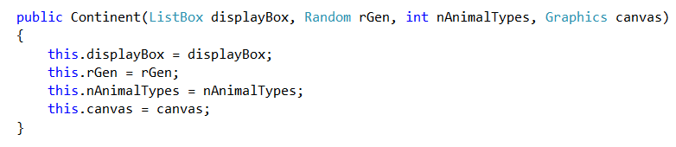
Continent Base Class Constructor
Notes:
You might want to break this apart to reduce coupling with the UI, but to make the architecture fit on the slides, we’ll tolerate it here.

Slide 30
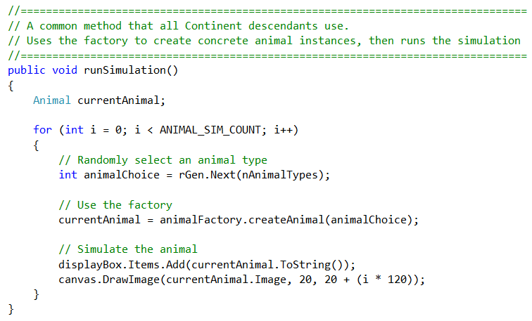
Continent Base Class Method
Notes:
This is the common method to run the simulation – in the continent base class.
Note that there is no need for polymorphism here. As long as each continent descendant class gets the right kind of factory in its constructor, the code is identical for all descendants.
Isn’t that lovely. Note the complete absence of code duplication.
IRL, those constants would come from some configuration object…

Slide 31
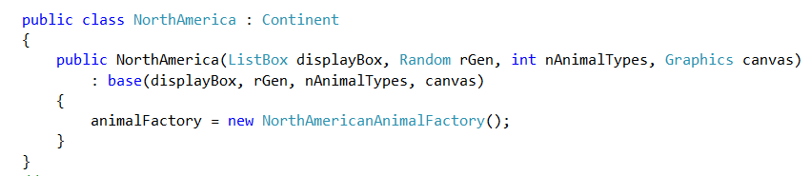
Continent Descendant
Notes:
So, what does the concrete continent child class look like?
In its constructor, it calls the parent to get the common code, then initialises its factory.
Since it makes the correct factory, runSimulation will create the correct kinds of animals
Like magic.
Australia is left as an exercise

Slide 32
Animal World Factory
Form code
Notes:
Exercise in practical
One thing you will notice is that there is very little code in the form.
Basically you create your continents, and, in the appropriate button click handler, you tell a continent instance to execute its runSimulation method.
Again we see this very common pattern in OO of lots of code underneath, and by the time we get to the upper management, it’s just a simple method call.

Slide 33
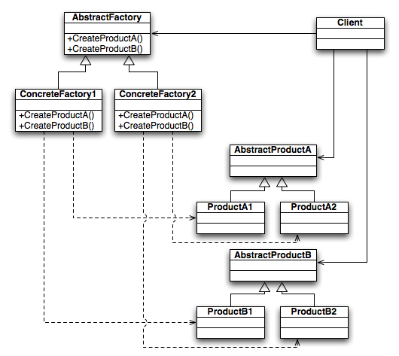
Abstract Factory Pattern
Notes:
The pattern we just made is an example of the “Abstract Factory Pattern”
A family of consumers and a family of factories.
You have an abstract factory (our interface), and appropriate concrete implementations of it
Here is the official diagram for the Abstract Factory Pattern.
These sorts of diagrams are often presented for the design patterns.
The solid lines are “needs” or “uses” (i.e. composition or aggregation).
The dotted lines are “creates”.
The hollow arrows are inheritance, like always.
Sometimes, reading the diagram is harder than writing the code…
So you have a Client that needs one or more products (In our example, Continents = Client, Animals = Product)
Here called Products A and B; there could of course be more.
In our example, we only made one kind of product. What would change if we wanted to make more products? ➔ The number of methods in the Factory interface.
We might have, for example, createAnimals and createPlants
Instead of creating the products itself by calling new directly, the client uses a factory – a member of the factory family.
The client gets a concrete factory (a class that implements the interface or abstract base class) which creates concrete instances of the products that it needs.
In practical, we will build several examples using the Abstract Factory Pattern.

Slide 34
Factory Method Pattern
In the Factory Method Pattern, the factory behaviour is implemented not as an object, but simply as an abstract method in the consumer class
Notes:
There is another common factory pattern in the GoF, the factory method pattern
Used when there is only one kind of product being produced
This is the case for animal world, so it could be implemented this way, although we will do the full Abstract Factory Pattern, to get the experience of building one.
If you are interested, you can do this as an extra exercise.
So the switch statement actually becomes part of the Continent class code

Slide 35
Main Theoretical Point
Decoupling object creation from object use is a powerful technique that supports code flexibility and reuse.

Slide 36
Practical (due Friday 9.00 am)
Implement the Animal World simulator as described in lecture.
To test your architecture:
After it is running, add a new animal to each continent.
Then add a new continent with its own animals.
If you’ve done it right, these changes will require minimal modification, and that will only be to a single class, the one directly involved with the change.
Notes:
We will see more of the factory pattern in class on Friday.

